Slide 1
Eda Case Study on bank loan DATA set
Praveen Sankadal​

Slide 2
Problem Statement
loan-providing companies face challenges in approving loans to individuals with insufficient or nonexistent credit history. This creates an opportunity for some consumers to take advantage of the system by defaulting on their loan payments..
The motive of this example examine is to perceive patterns and signs that could assist are expecting whether a consumer may additionally have issue repaying part of a loan. By the use of Exploratory Data Analytics (EDA), our purpose is to advantage insights that can be used to take appropriate movements, including declining loans, lowering mortgage amounts, or extending loans to at-chance customers with higher hobby fees.
The closing purpose is to make certain that deserving consumers who are capable of repaying their loans aren't rejected, even as minimizing the chance of default for the lending institutions. Through this EDA evaluation, we purpose to pick out key attributes and elements that affect the probability of loan default, allowing more knowledgeable decision-making within the loan approval manner.

Slide 3
steps
Data understanding and analysis
Data cleaning and manipulation
Analyzing facts imbalance and carrying out univariate and segmented analysis , and bivariate analysis
Analysis for top correlations in defaulters and repayers
Merged analysis of application data dataset and previous application dataset
Recommended and risky groups

Slide 4
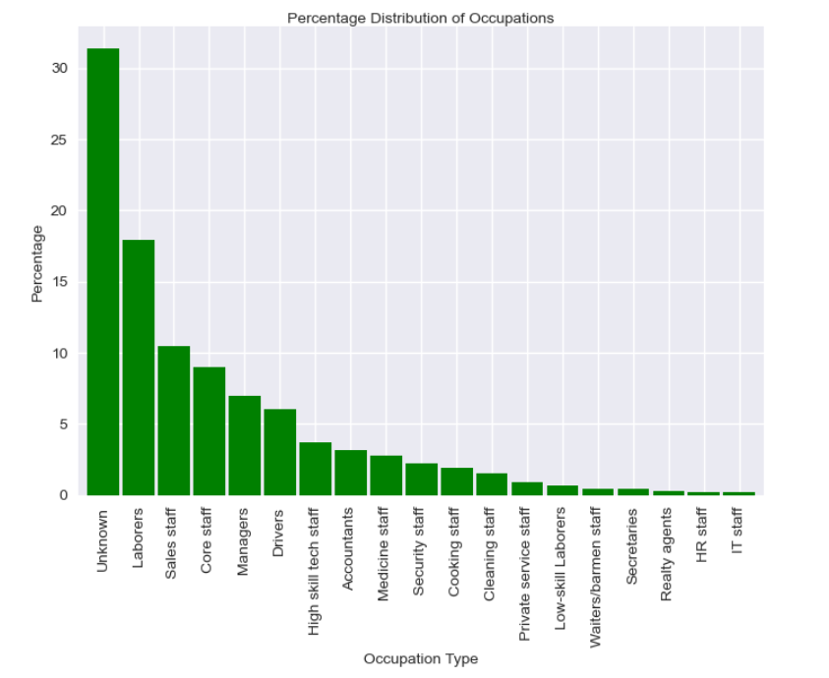
Analyzing Occupation
On analyzing the data set found that most of the applicants Occupation is Missing and named as “UnKnown” , followed by most of the applicants are from labor, sales staffs, core staff Occupations

Slide 5
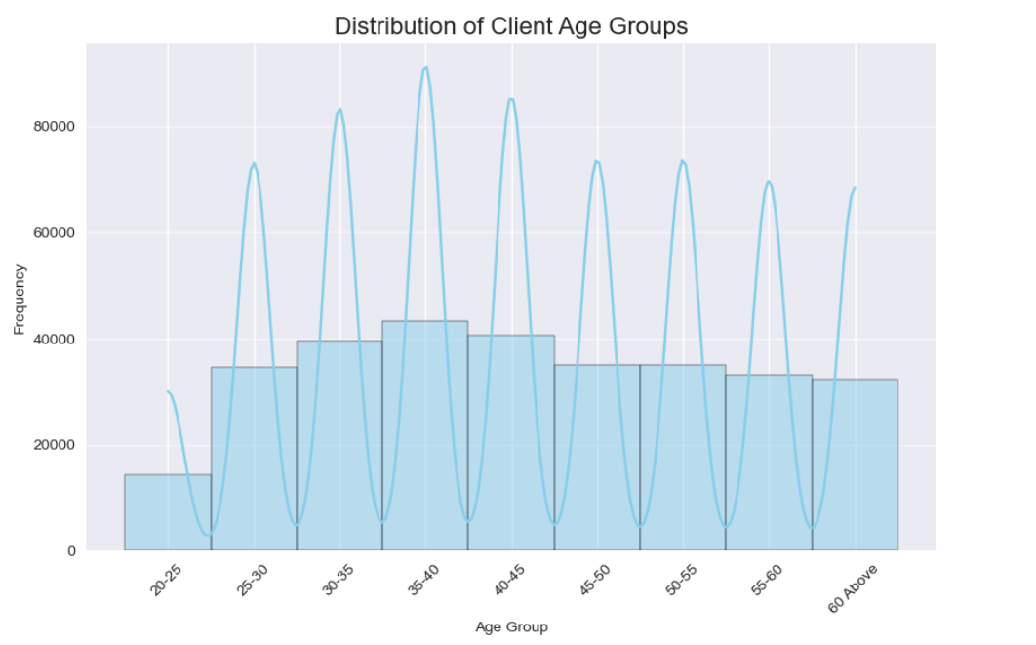
Analyzing age
On analyzing the data set found that, the requirement for loan as gradually increased from age 25 and gradually decreased from 40 and above

Slide 6
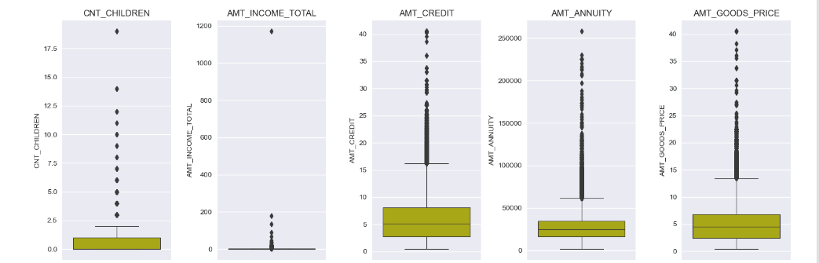
Finding Outliners
Some columns have extreme difference and considered as outliners, AMT_CREDIT, AMT_ANNUITY, AMT_GOODS_PRICE have unexpected / out of the normal range values
AMT_INCOME_TOTAL has outliers, indicating higher income for some loan applicants.

Slide 7
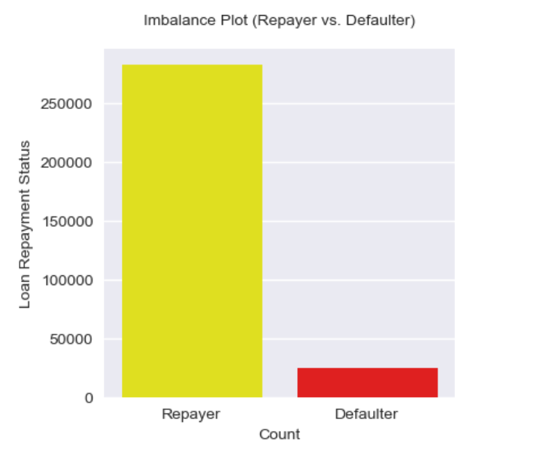
Imbalance data analysis
Analyzing the application data set, found that, the percentage value of applicants repaying there loan is 91.93 % and defaulters is 8.07%

Slide 8
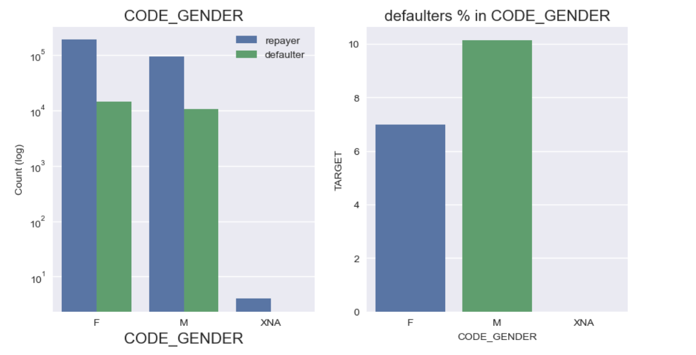
Analyzing gender
On analyzing the defaulter rates fount males have high default rate (~10%) compare to female ( ~7%)

Slide 9
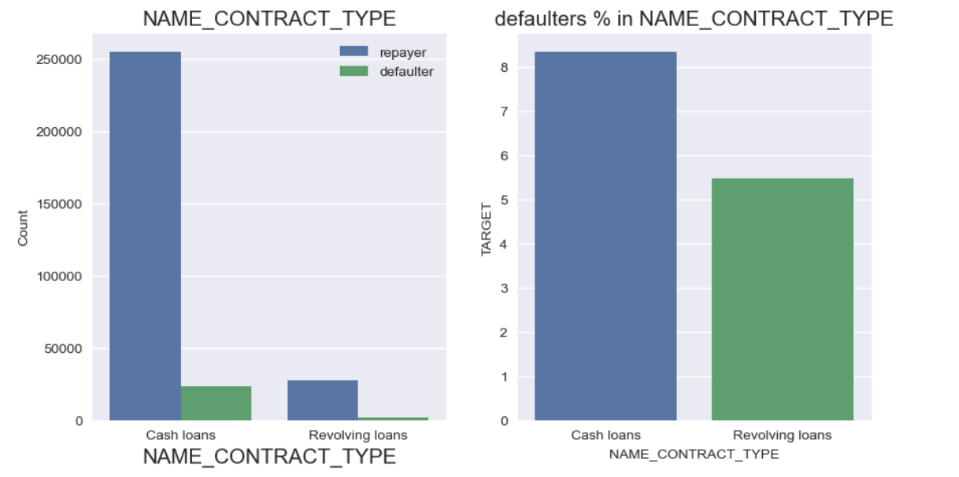
Analyzing loan type
A small percent (10%) of all loans are revolving loans. When it involves loan default, about eight-nine percent of mortgage candidates and 5-6% of individuals declare the mortgage lower.

Slide 10
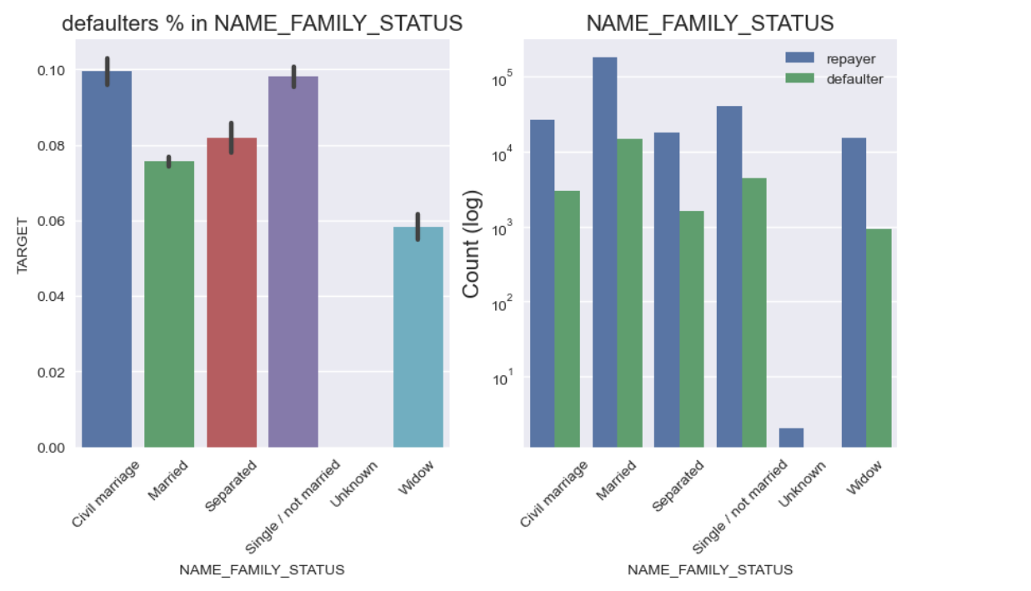
Analyzing family status
When studying the default rates, civil marriages have the very best percent at around 9.5%, even as widows have the lowest rate at approximately 5.8%, besides for the Unknown class. The majority of candidates are married, followed by using single or unmarried people, and those in civil marriages

Slide 11
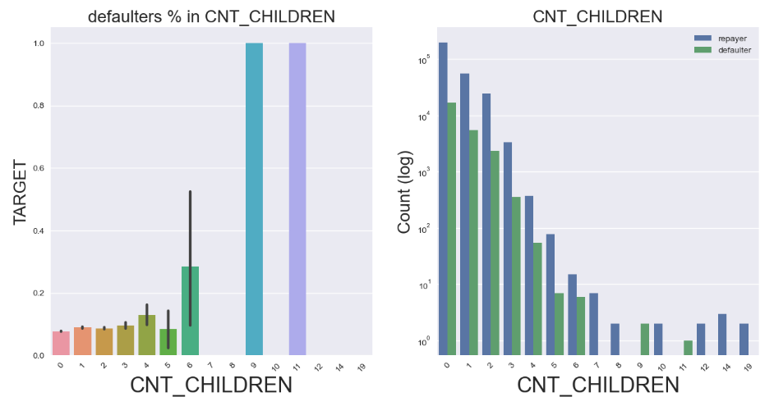
Analyzing children
Applicants having children less then 4 seems to take loan and have low default rates , compare to applicants having children more then 8 and above

Slide 12
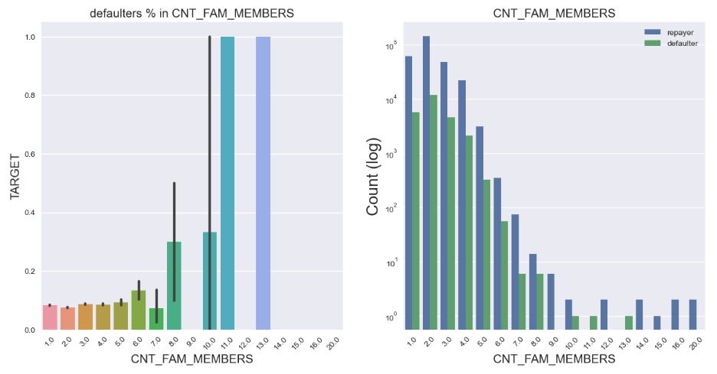
Analyzing family member count
The pattern located for own family members follows same pattern as that of no of children. having a more family members seems to elevate the chance of loan defaulting.

Slide 13
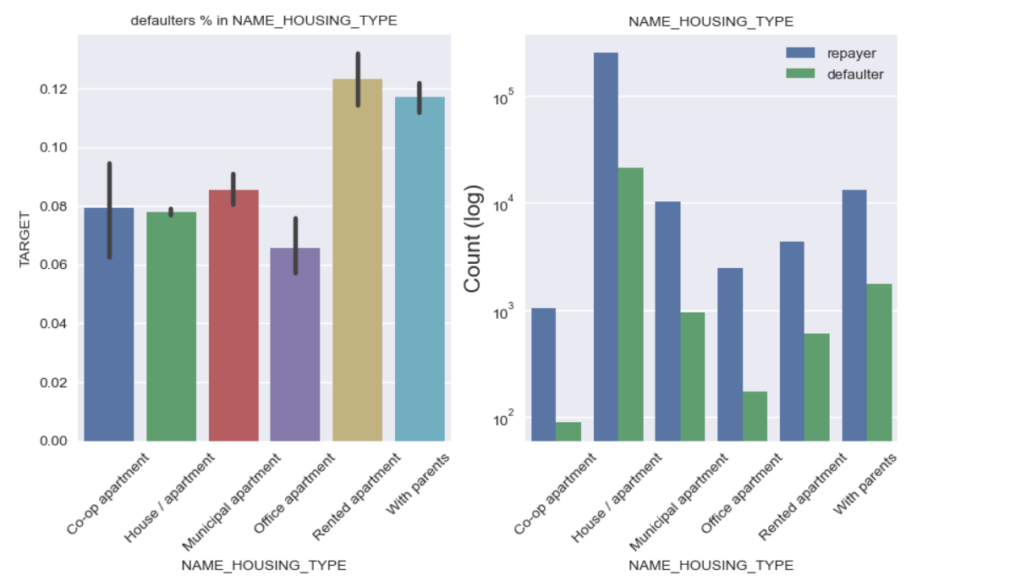
Analyzing applicants house type
clients who live in rented apartments (12%) and with parents (11.5%) are more likly to be a defaulters
people leaving in co-op apartment and office apartment have low rate being a defaulters

Slide 14
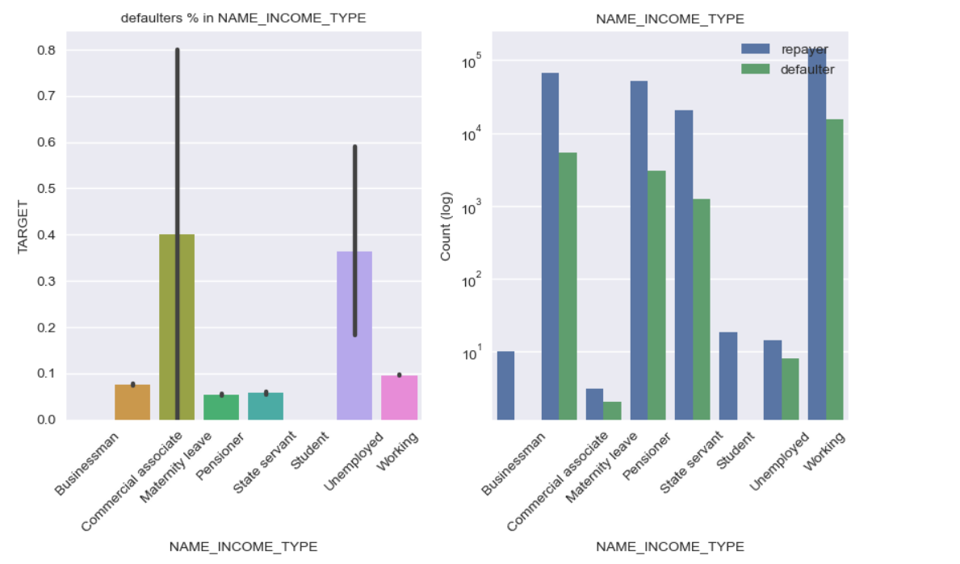
Analyzing Income type
businessman and students have zero default rates
consumers on maternity leave and unemployed are more likely to become defaulters as they don't have any source of income.

Slide 15
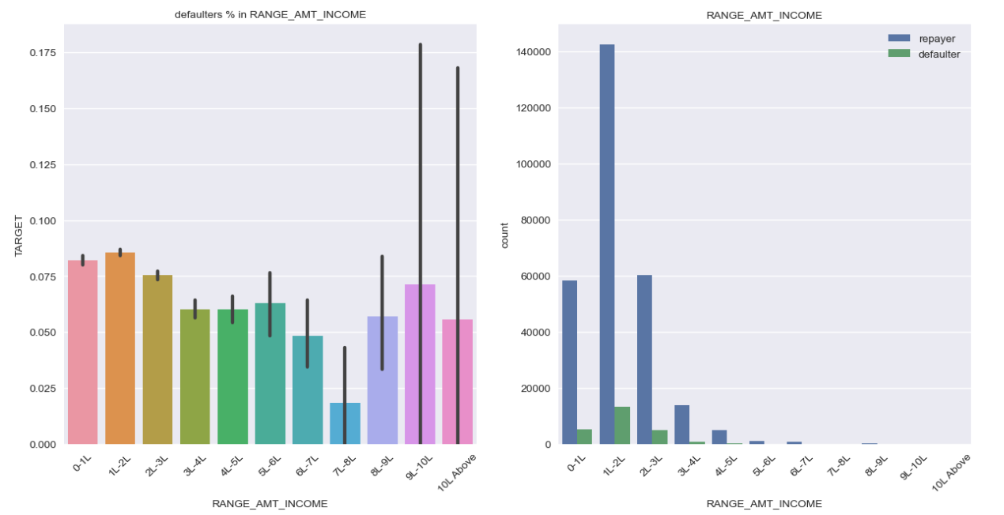
Analyzing income
Applicants incomes 5L and above are much less likely to default,
Applicants whose incomes less then 3 Lakhs have a have a default rate of 7.5%

Slide 16
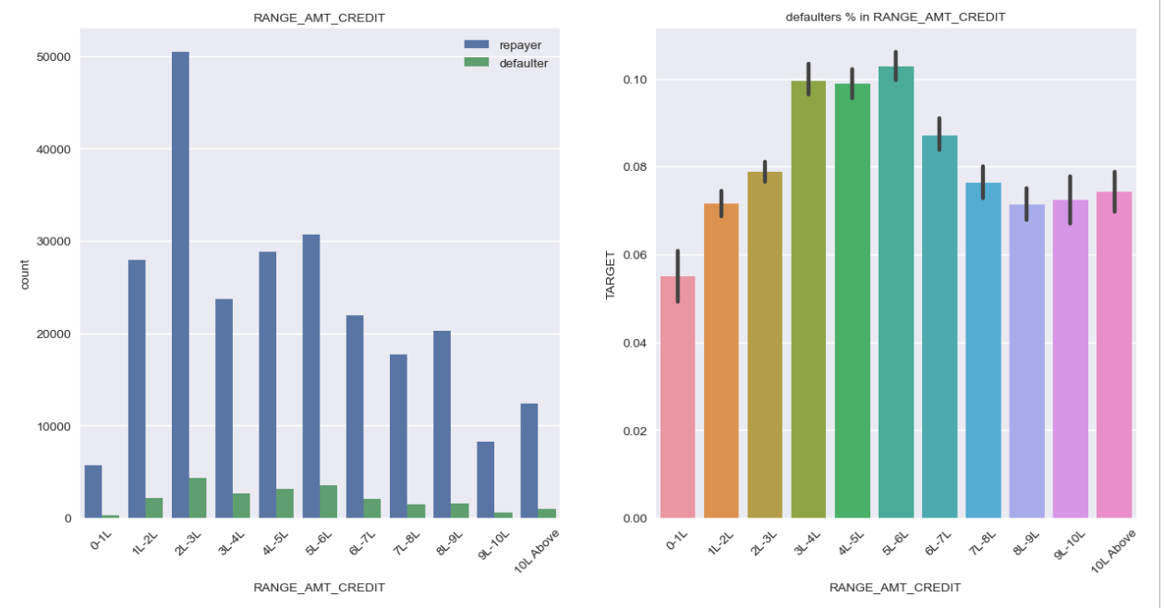
Analyzing loan credit
Most applicants have taken the loan of 2L-3L, and default rates are quit higher for the applicants who have taken the loan amount in the range of 3L – 6L

Slide 17
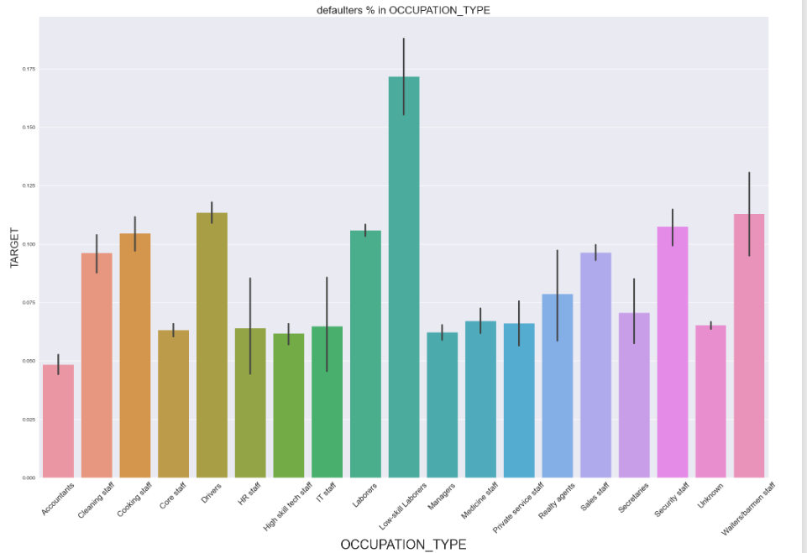
Analyzing occupation
Low skilled labors, Drivers , waiters/barman staffs have the high default rate

Slide 18
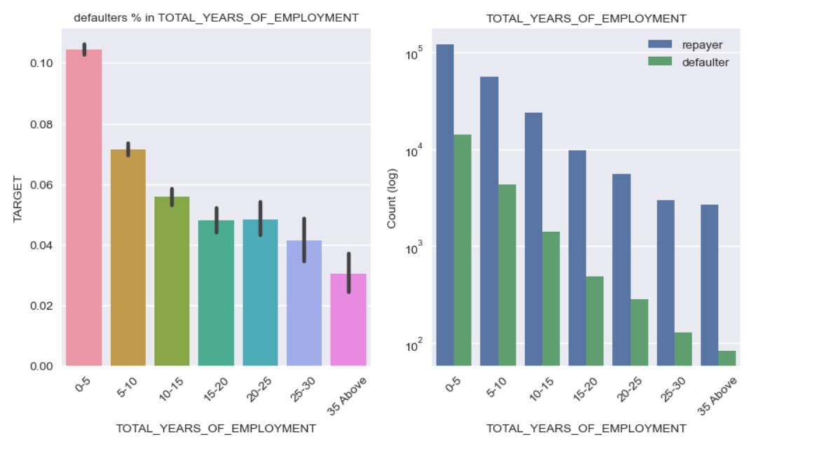
Analyzing total year of work
Default rate gradually drops as the work experience of the applicant increases, no doubt income/ salary increase with work experience, applicant can repay there loans

Slide 19
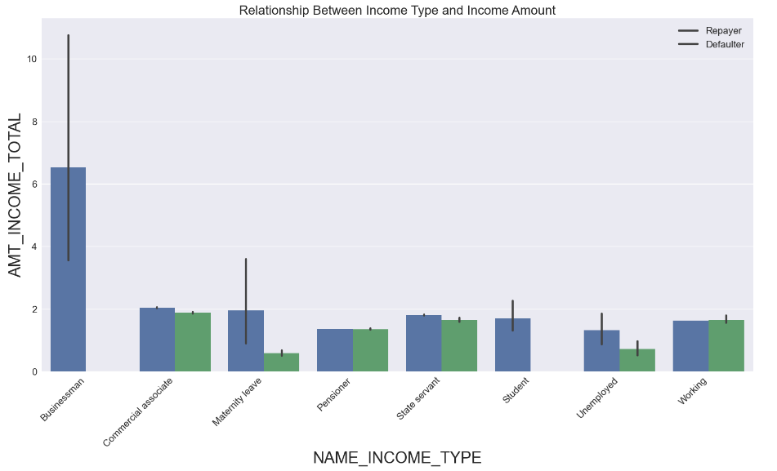
Analyzing income type vs total income
Default rate for businessman is almost to zero, showcasing the highest earnings stage. Additionally, thinking about the anticipated range with a 95% confidence stage, it appears that the earnings fall inside a range barely beneath 4 lakhs and extends barely beyond 10 lakhs.

Slide 20
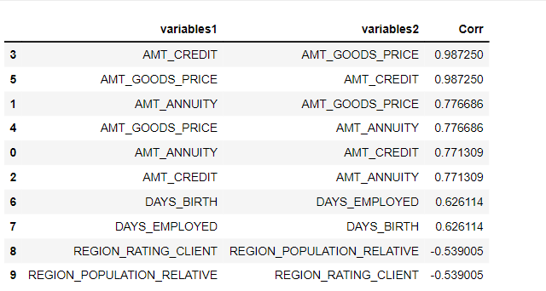
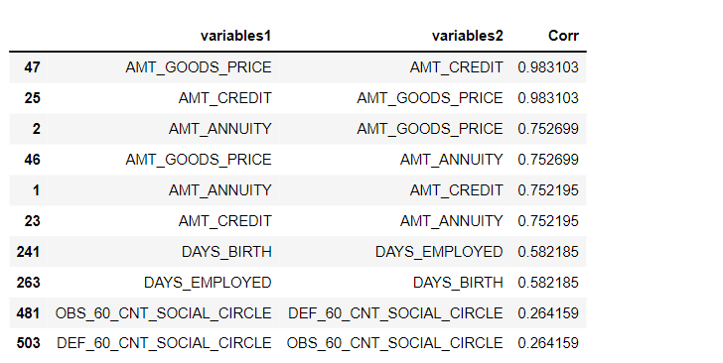
Top correlation among repayer and defaulter’s
Top 10 Correlations in Both Repayer and Defaults are almost Same
Top 10 Corr for Repayer
Top 10 Corr for Defaulters

Slide 21
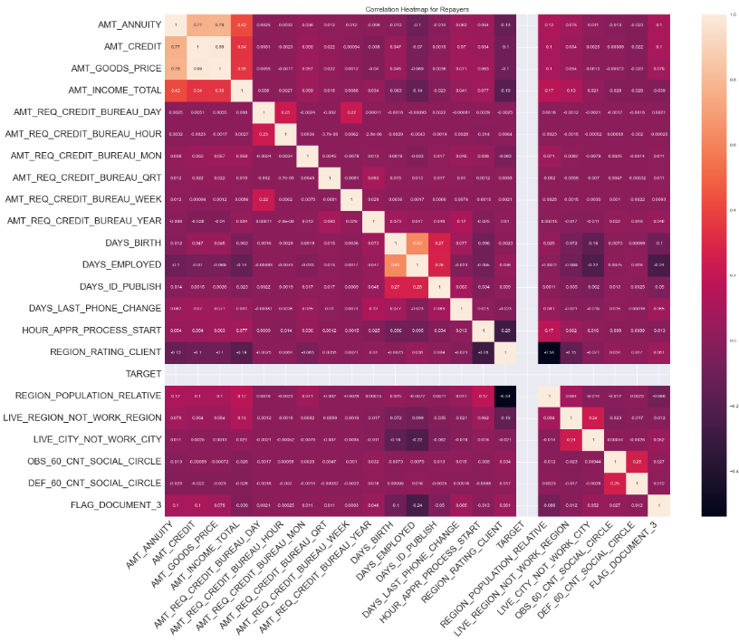
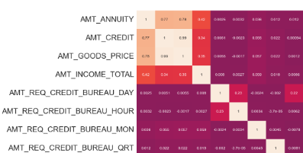
correlation for repayer
We plotted a heat map, for target value 1, considering the repayers , AMT_CREDIT show a high correlation with AMT_ANNUITY , AMT_INCOME_TOTAL and AMT_GOODS_PRICE

Slide 22
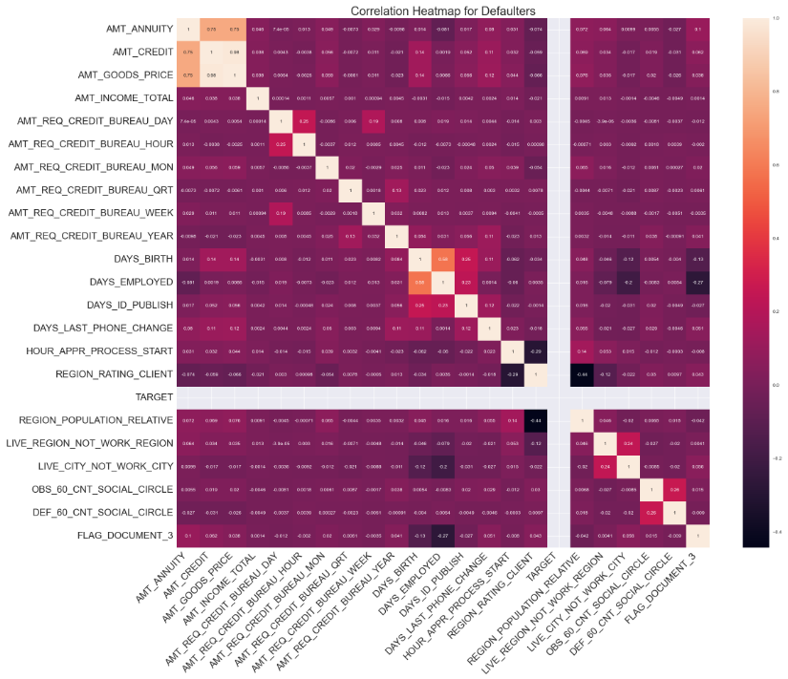
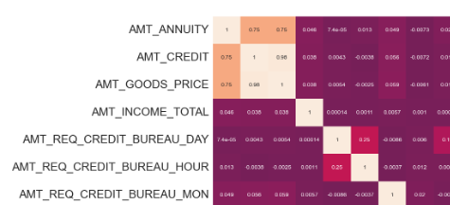
correlation for defaulters
Correlation for defaulters apereas to se same as of repayers.

Slide 23
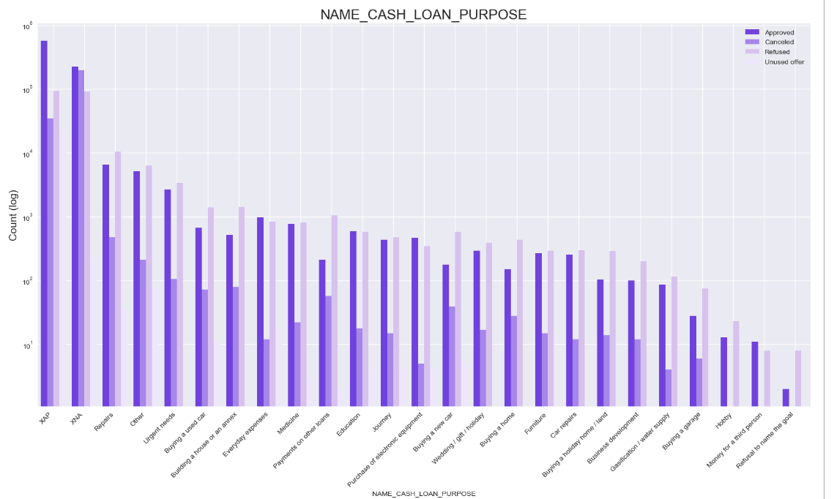
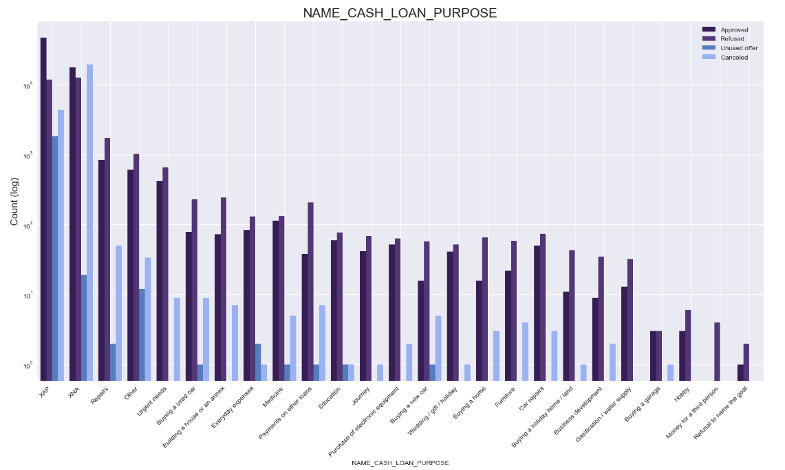
Merged analysis
Analysis of defaulters and repayers based on the loan purpose and loan status, the loan purpose is higher for unknow reasons like(XAP,XNA)
loan approved for repair purpose seems to have higher default repayer

Slide 24
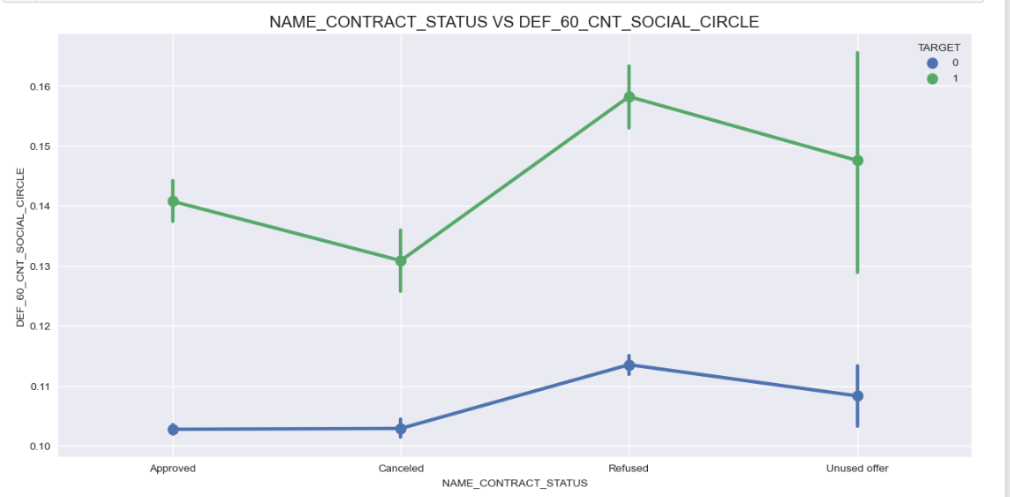
Merged analysis
Relationship Between applicants with Recent Default and Their Social Circle, Along with loan Status

Slide 25
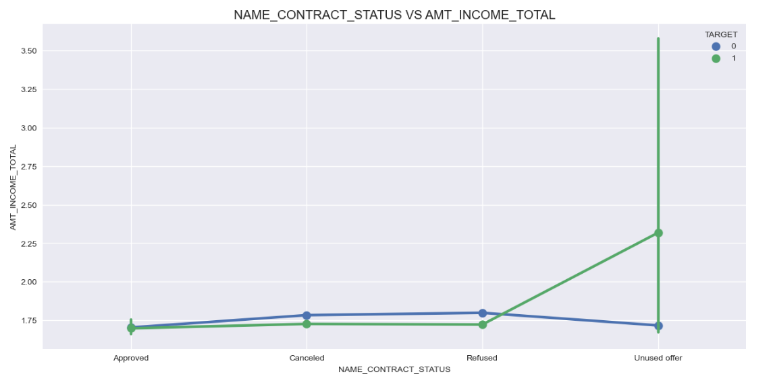
Merged analysis
Applicants who have unused approved loan also defaulted despite having a higher average income than others.

Slide 26
Recommended groups
Income type
Dat_birth
Occupation
type
Amt_income
CONTRACT
STATUS
Businessman,
Pensioners,
State servants
Old age applicants, age of 60 and above
High Skilled Tech Staffs,
HR-Staffs,
Accountants
Applicants with income above 6and above
Clients who have previously approved loan, or with unused loan status

Slide 27
risky groups
income_Type
House_type
Cnt_children,CNT_family
Flaged column
Occupation_type
unemployed, maternity leave
Applicants living in rented apartments, with parents
Applicants having family members more then 7-8 / children more then 5-6,
Applicants who do not provide valid documents and phone no
Low skilled, labours, barmans, Waiters

Slide 28
Thank you
Praveen sankadal

